Slide 1
Bar Charts & Plotting Pivot Tables

Slide 2
Bar Charts
Bar charts are very similar to histograms which are used to represent the distribution of values in data
While a histogram typically represent the frequency distribution of continuous variables, a bar chart is a comparison of discrete variables
Another way to think about it is, a histogram presents numerical data and a bar chart shows categorical data

Slide 3
Creating a Bar Chart Using the bar Method
One way to create a bar chart is by using matplotlib’s bar method
This is similar to the hist method, where you provide the data to plot and some additional parameter configurations import pandas as pd import matplotlib.pyplot as plt plt.bar(
data_for_x_axis, data_for_y_axis, #other optional parameters ... )

Slide 4
Creating a Bar Chart Using the plot Method
Another very easy way to create a bar chart, is by using a DataFrame’s built-in plot method
Remember when we were working with the Yelp data, and we asked the question “How many businesses are there in each city?” Here’s an example where we visualize that data: #count the records for each city and get a new DataFrame df_city_value_counts = df['city'].value_counts() #call the plot method and set the kind parameter to ‘bar’ df_city_value_counts.plot(kind='bar', figsize=(12, 6), fontsize=12, legend=False, title="Number of Businesses Per City") plt.ylabel("Number of businesses") plt.show()

Slide 5
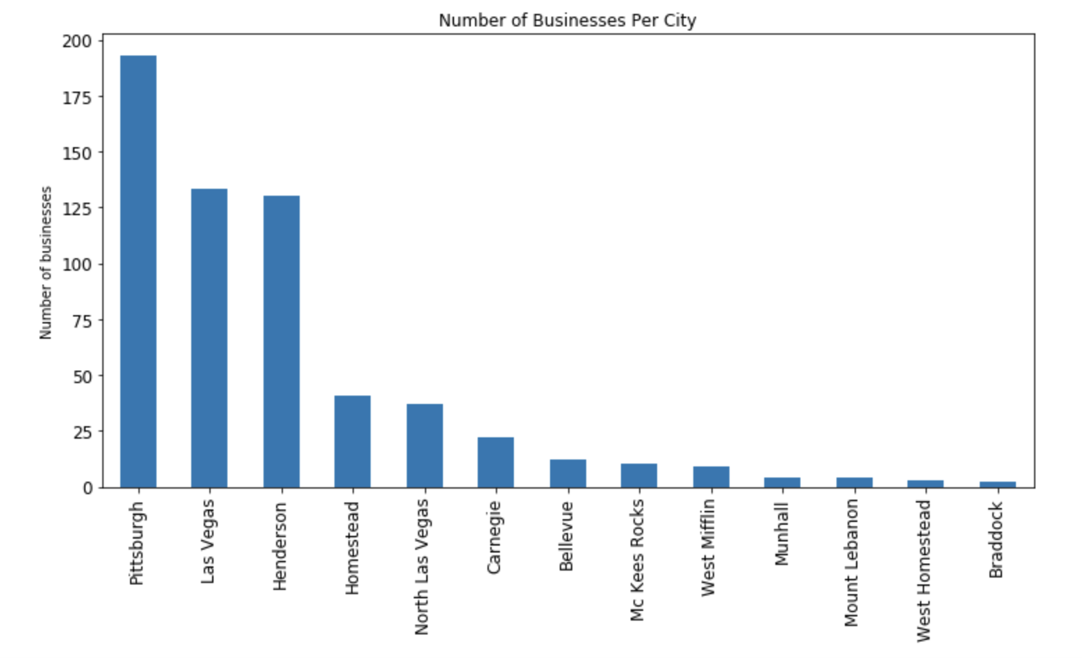
Creating a Bar Chart Using the plot Method
Another very easy way to create a bar chart, is by using a DataFrame’s built-in plot method
Remember when we were working with the Yelp data, and we asked the question “How many businesses are there in each city?” Here’s an example where we visualize that data:

Slide 6
Plotting a Pivot Table
Here’s a visualization of a pivot table that displays the average (mean) star rating for bars and restaurants: bar_rest = df["category_0"].isin(["Bars", "Restaurants"]) df_bar_rest = df[bar_rest] #pivot along category pivot_state_cat = pd.pivot_table(df_bar_rest, index=["category_0"]) #filter the df_bar_rest DataFrame columns pivot_state_cat = pivot_state_cat[["stars"]] #call the plot method and set the kind parameter to ‘bar’ pivot_state_cat.plot(kind='bar', figsize=(12, 6), fontsize=12, legend=False, title="Average Star Rating for Bars & Restaurants") plt.xlabel("Category") plt.ylabel("Average star rating") plt.show()

Slide 7
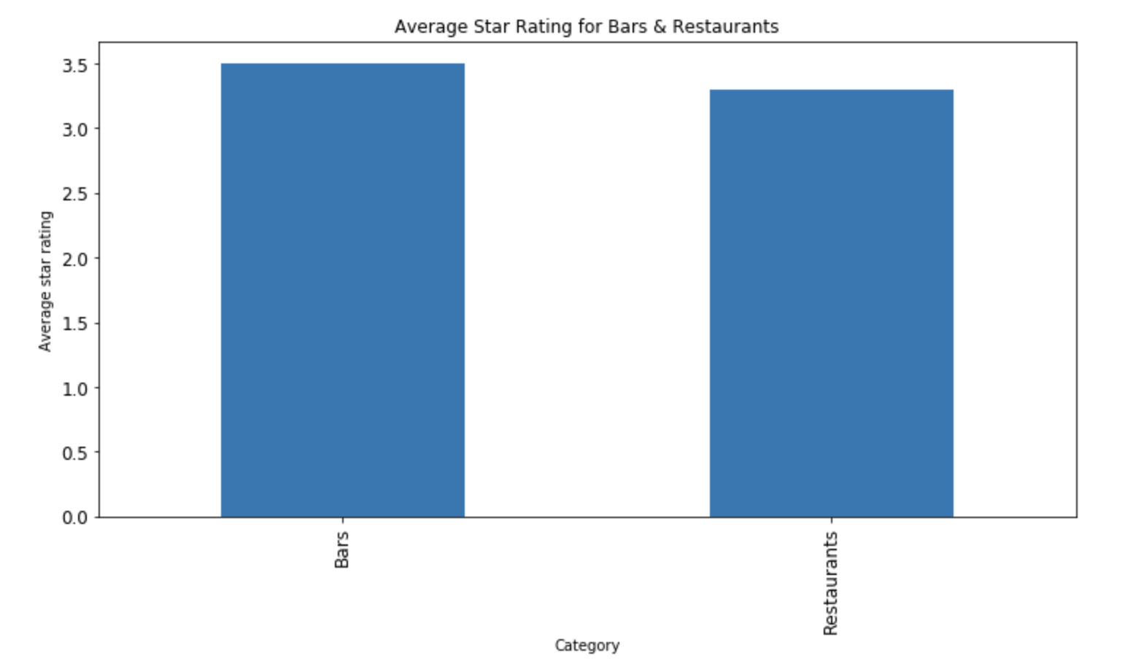
Plotting a Pivot Table
Here’s a visualization of a pivot table that displays the average (mean) star rating for bars and restaurants:

